Slide 1

ECOLAB DIGITAL CENTRE (P). Ltd. Term Deposit Subscription Prediction
Submitted By:-
Vaibhav Arora

Slide 2
Problem Statement
It is very cumbersome to get business from a new customer as compared to an old customer. Therefore, a lot of human effort and resources are spent by the banks to attract new customer, but still, the banks were not sure whether the customer will show their faith on them. Therefore it is wise to focus on our pre-existing as well as new customer base and come up with a new model/strategy in such a way that term deposit increases drastically and its operational cost for target audience decreases.

Slide 3
Methodology
Step 1.Understanding the problem statement.
Step 2.Overview of features.
Step 3.Performed Exploratory Data Analysis under which Univariate, Bivariate and Statistical analysis has been done as well as Auto EDA through dtale library.
Step 4.Data Pre-Processing in three ways like formation of manual groupings, groups of quantile binning, detailed Feature Engineering and Outlier Treatment.
Step 5 Normalization, Encoding and checking for multi-collinearity.
Step 6 Treatment of Imbalanced Dataset by SMOTE.
Step 7 Feature Importance by tree classifier, permutation method.
Step 8 Dropping of corelated, constant and duplicates.
Step 9 Splitting the dataset in train-test in ratio 75:25.
Step 10 Model fitting used best 5 algorithms like Random Forest, Logistic Regression etc.
Step 11 Performed Hyperparameter Optimization .
Step 12 Created Pipeline through which test data has been validated.

Slide 4
Exploratory Data Analysis’s Insights
May is having highest marketing activity (25.3%) whereas December is having lowest marketing activity (0.985%).
During spring and summer marketing team of the bank have put their more efforts to make people subscribe term deposits. However, individuals opted to subscribe more term deposits accounts during the season of fall and winter.
When a target client is called more than 5 times the likelihood that he or she will accept in subscribing to a term deposit diminishes and after the third call the probability that a potential client will refuse to subscribe a term deposit increases drastically.
Most of the potential clients the bank targeted have 30-35 years old.
20s and younger: Around 60% of potential clients in this category subscribed to term deposit subscriptions.
30s - 50s: Around 40% of the potential clients in this category subscribed to term deposits accounts.
60s and older: Around 76% subscribed term deposits!
The youngest and eldest population segments were the most likely to open a term deposit account.

Slide 5
Management, Blue-Collars and Technicians people received the most offers from the marketing department to suscribeb term deposits whereas Students, entrepreneurs and housemaids received the less amount of offers from the marketing department.
Approx 75% of the students subscribed term deposits whereas 68% of people who were retired were willing to subscribe term deposits.
Approx 58% of the unemployed are willing to subscribe term deposits.
The marketing campaign targets fewer people who have an average balance and high balance and People with no balance and low balance were more likely to have a house loan.

Slide 6
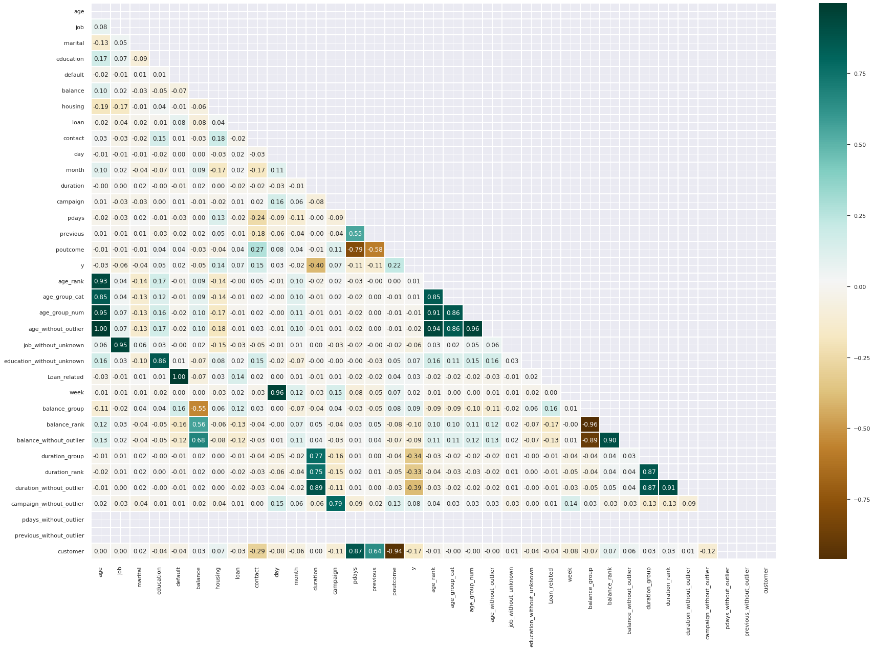
Variable Selection Strategy
Determined Important feature through Extra tree Classifier and Permutation Importance.
Checked correlation among different features.

Slide 7
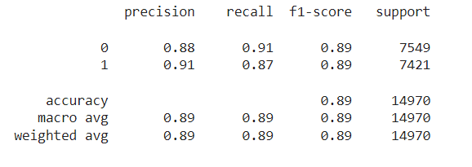
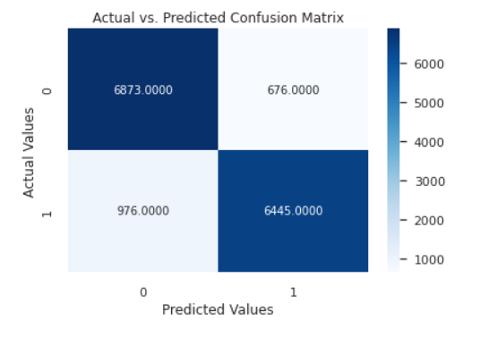
Results
The top three most important features for our classifier are Duration (how long it took the conversation between the sales representative and the potential client), contact (number of contacts to the potential client within the same marketing campaign), month (the month of the year).
Before Hyperparameter Optimization f1 score is 0.82 .
After Hyperparameter Optimization f1 score is 0.89.

Slide 8
Business Recommendation
For the next marketing campaign, it will be wise for the bank to focus the marketing campaign during the months of March, September, October and December.
Potential clients opted to subscribe term deposits during the seasons of fall and winter. The next marketing campaign should focus its activity throughout these seasons.
A policy should be implemented that states that no more than 3 calls should be applied to the same potential client in order to save time and effort in getting new potential clients. Remember, the more we call the same potential client, the likely he or she will decline to open a term deposit.
Since duration of the call is the feature that most positively correlates with whether a potential client will open a term deposit or not, by providing an interesting questionnaire for potential clients during the calls the conversation length might increase.
the next marketing campaign should focus on individuals of average and high balances in order to increase the likelihood of subscribing to a term deposit.
By combining all these strategies and simplifying the market audience the next campaign should address, it is likely that the next marketing campaign of the bank will be more effective than the current one.

